Slide 1
Stocko Sprint 3
Brendan Lucich, Alex Davis, Andrew Setka, Brady Mack
Source Code: https://github.com/Asetka/Stocko/tree/dev
Project Website: https://stocko.xyz
Jira: https://housing.atlassian.net/jira/software/projects/STOCKO/boards/2/backlog
ReadMe: https://github.com/Asetka/Stocko/tree/dev/sprint_deliverables

Slide 2
Stocko
Web app designed to provide casual investors with more information for long-term personal investments
Focused on an analytical process to investment in stocks
Use financial data about a company to provide evaluation metrics to determine the intrinsic value of the company

Slide 3
Backlog of Sprint 2 Goals
Story | Assignee(s) | Points
Create new Chart and identify the data needed for it | Andrew | 6
Change any UI that looks weird and fix some calculations | Davis | 8
Fix and optimize the positions API | Brady | 8
Create the education page | Brendan | 21
Document the API | Andrew | 6
Notes:
Jira
https://housing.atlassian.net/jira/software/projects/STOCKO/boards/2/backlog
https://docs.google.com/document/d/11fXwnk1gAuYx-7HyRQba3VkH9B8AzGvIzvyoV3V2uHA/edit

Slide 4
Sprint 2 vs Sprint 3
In Sprint 3 we focused on doing the following better
Identifying bugs and coming up with solutions to them as a team
Learning more about how the others were implementing their piece
Asking each other for opinions on ways we implement pieces
Making the UI flow slightly better
Make the app easier for a user to understand

Slide 5
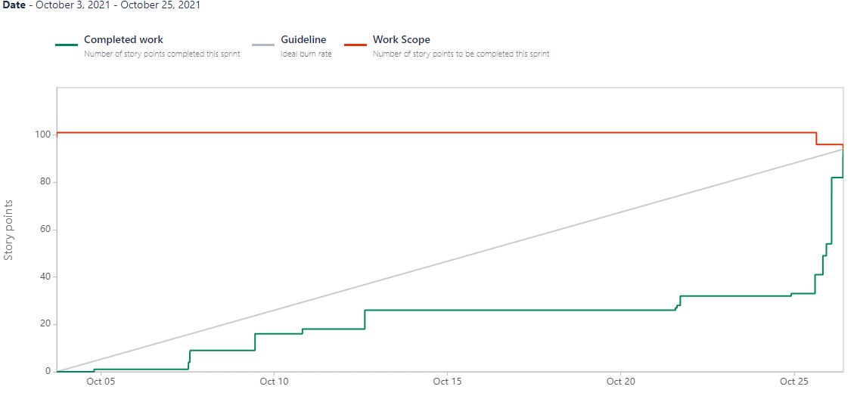
Burnup Chart (as of Sprint 3 Completion)

Slide 6
Sprint 3 Retrospective
Did a great job of working together on identifying and solving bugs
The user interface looks polished
Error checking was added in and works well
draft for what didn’t go well
draft for what we could improve
Brady ran into some pathing issue that was causing him to get results twice from API and then not at all

Slide 7
Team Member Contributions
Brendan
Created the education page and explained to us what the numbers mean
Alex
Redid any UI elements that seemed strange and fixed some calculation bugs
Andrew
Made a new more informative chart, worked on the API documentation
Brady
Optimized the speed of the API and added error checking to positions
DRAFT

Slide 8
Andrew’s Contribution
Made a new more informative chart, worked on the API documentation
Added in authenticated API calls
DRAFT

Slide 9
Davis’ Contribution
Redid any UI elements that seemed strange and fixed some calculation bugs
DRAFT

Slide 10
Brady’s Contribution
Optimized the speed of the API and added error checking to positions
DRAFT

Slide 11
Brendan’s Contribution
Created the education page and explained to us what the numbers mean
DRAFT

Slide 12
Demo
Show the app working
Demonstrate the standard user flow
Explain what the calculations mean

